Slide 1
Circular Singly Linked List

Slide 2
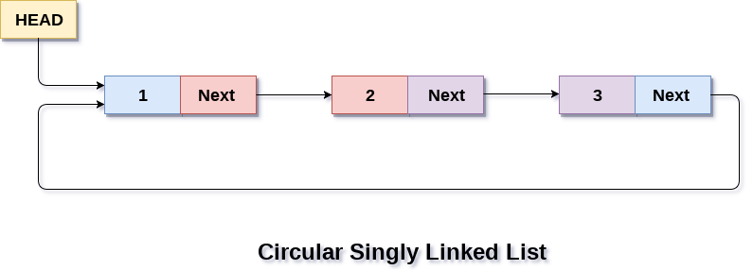
In a circular Singly linked list, the last node of the list contains a pointer to the first node of the list. We can have circular singly linked list as well as circular doubly linked list.
We traverse a circular singly linked list until we reach the same node where we started. The circular singly liked list has no beginning and no ending. There is no null value present in the next part of any of the nodes.
The following image shows a circular singly linked list.
Circular linked list are mostly used in task maintenance in operating systems. There are many examples where circular linked list are being used in computer science including browser surfing where a record of pages visited in the past by the user, is maintained in the form of circular linked lists and can be accessed again on clicking the previous button.

Slide 3
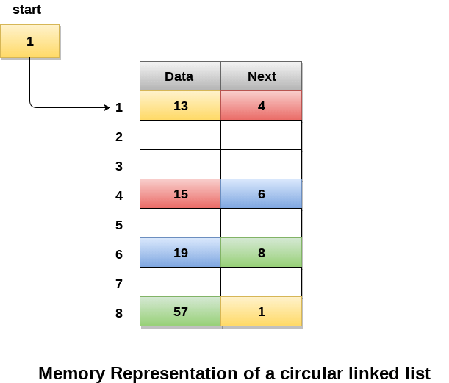
Memory Representation of circular linked list:
In the following image, memory representation of a circular linked list containing marks of a student in 4 subjects. However, the image shows a glimpse of how the circular list is being stored in the memory.
The start or head of the list is pointing to the element with the index 1 and containing 13 marks in the data part and 4 in the next part. Which means that it is linked with the node that is being stored at 4th index of the list.
However, due to the fact that we are considering circular linked list in the memory therefore the last node of the list contains the address of the first node of the list.

Slide 4
We can also have more than one number of linked list in the memory with the different start pointers pointing to the different start nodes in the list. The last node is identified by its next part which contains the address of the start node of the list. We must be able to identify the last node of any linked list so that we can find out the number of iterations which need to be performed while traversing the list.

Slide 5
Operations on Circular Singly linked list:
Traversing in Circular Singly linked list
Traversing in circular singly linked list can be done through a loop. Initialize the temporary pointer variable temp to head pointer and run the while loop until the next pointer of temp becomes head. The algorithm and the c function implementing the algorithm is described as follows.
Algorithm
STEP 1: SET PTR = HEAD
STEP 2: IF PTR = NULL
WRITE "EMPTY LIST" GOTO STEP 8 END OF IF
STEP 4: REPEAT STEP 5 AND 6 UNTIL PTR → NEXT != HEAD
STEP 5: PRINT PTR → DATA
STEP 6: PTR = PTR → NEXT
[END OF LOOP]
STEP 7: PRINT PTR→ DATA
STEP 8: EXIT

Slide 6
2. Searching in circular singly linked list
Searching in circular singly linked list needs traversing across the list. The item which is to be searched in the list is matched with each node data of the list once and if the match found then the location of that item is returned otherwise -1 is returned.
The algorithm and its implementation in C is given as follows.
Algorithm
Step 1: SET PTR = HEAD
STEP 2: IF PTR = NULL
WRITE "EMPTY LIST" GOTO STEP 7 END OF IF
STEP 3: IF HEAD → DATA = ITEM
RETURN
[END OF IF]
STEP 4: REPEAT STEP 5 TO 7 UNTIL PTR->next != head
STEP 5: if ptr → data = item RETURN End of IF
STEP 6: PTR = PTR → NEXT
[END OF LOOP]
STEP 7: EXIT

Slide 7
Insertion into circular singly linked list at beginning
There are two scenario in which a node can be inserted in circular singly linked list at beginning. Either the node will be inserted in an empty list or the node is to be inserted in an already filled list.
Firstly, allocate the memory space for the new node by using the malloc method of C language.
struct node *ptr = (struct node *)malloc(sizeof(struct node));
In the first scenario, the condition head == NULL will be true. Since, the list in which, we are inserting the node is a circular singly linked list, therefore the only node of the list (which is just inserted into the list) will point to itself only. We also need to make the head pointer point to this node. This will be done by using the following statements.
if(head == NULL)
{
head = ptr;
ptr -> next = head;
}
In the second scenario, the condition head == NULL will become false which means that the list contains at least one node. In this case, we need to traverse the list in order to reach the last node of the list. This will be done by using the following statement.
temp = head;
while(temp->next != head)
temp = temp->next;

Slide 8
At the end of the loop, the pointer temp would point to the last node of the list. Since, in a circular singly linked list, the last node of the list contains a pointer to the first node of the list. Therefore, we need to make the next pointer of the last node point to the head node of the list and the new node which is being inserted into the list will be the new head node of the list therefore the next pointer of temp will point to the new node ptr.
This will be done by using the following statements.
temp -> next = ptr;
the next pointer of temp will point to the existing head node of the list.
ptr->next = head;
Now, make the new node ptr, the new head node of the circular singly linked list.
head = ptr;
in this way, the node ptr has been inserted into the circular singly linked list at beginning.

Slide 9
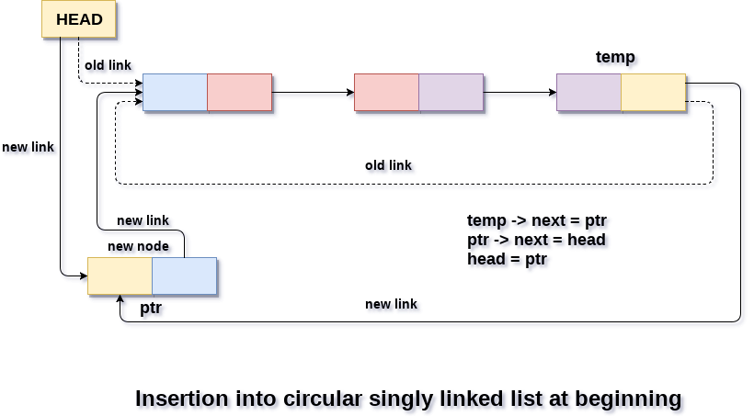

Slide 10
Algorithm
Step 1: IF PTR = NULL
Write OVERFLOW Go to Step 10 [END OF IF]
Step 2: SET NEW_NODE = PTR
Step 3: SET NEW_NODE -> DATA = VAL
Step 4: SET TEMP = HEAD
Step 5: Repeat Step 8 while TEMP -> NEXT != HEAD
Step 6: SET TEMP = TEMP -> NEXT
[END OF LOOP]
Step 7: SET NEW_NODE -> NEXT = HEAD
Step 8: SET TEMP → NEXT = NEW_NODE
Step 9: SET HEAD = NEW_NODE
Step 10: EXIT

Slide 11
Insertion into circular singly linked list at the end
There are two scenario in which a node can be inserted in circular singly linked list at beginning. Either the node will be inserted in an empty list or the node is to be inserted in an already filled list.
Firstly, allocate the memory space for the new node by using the malloc method of C language.
struct node *ptr = (struct node *)malloc(sizeof(struct node));
In the first scenario, the condition head == NULL will be true. Since, the list in which, we are inserting the node is a circular singly linked list, therefore the only node of the list (which is just inserted into the list) will point to itself only. We also need to make the head pointer point to this node. This will be done by using the following statements.
if(head == NULL)
{
head = ptr;
ptr -> next = head;
}
In the second scenario, the condition head == NULL will become false which means that the list contains at least one node. In this case, we need to traverse the list in order to reach the last node of the list.

Slide 12
This will be done by using the following statement.
temp = head;
while(temp->next != head)
temp = temp->next;
At the end of the loop, the pointer temp would point to the last node of the list. Since, the new node which is being inserted into the list will be the new last node of the list. Therefore the existing last node i.e. temp must point to the new node ptr. This is done by using the following statement.
temp -> next = ptr;
The new last node of the list i.e. ptr will point to the head node of the list.
ptr -> next = head;
In this way, a new node will be inserted in a circular singly linked list at the beginning.

Slide 13
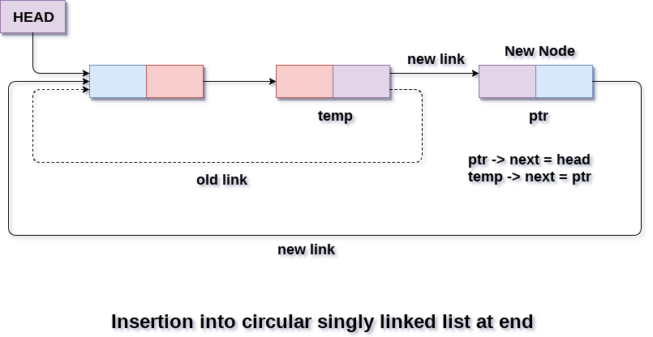

Slide 14
Algorithm
Step 1: IF PTR = NULL
Write OVERFLOW Go to Step 9 [END OF IF]
Step 2: SET NEW_NODE = PTR
Step 3: SET NEW_NODE -> DATA = VAL
Step 4: SET NEW_NODE -> NEXT = HEAD
Step 5: SET TEMP = HEAD
Step 6: Repeat Step 8 while TEMP -> NEXT != HEAD
Step 7: SET TEMP = TEMP -> NEXT
[END OF LOOP]
Step 8: SET TEMP -> NEXT = NEW_NODE
Step 9: EXIT

Slide 15
Deletion in circular singly linked list at beginning
In order to delete a node in circular singly linked list, we need to make a few pointer adjustments.
There are three scenarios of deleting a node from circular singly linked list at beginning.
Scenario 1: (The list is Empty)
If the list is empty then the condition head == NULL will become true, in this case, we just need to print underflow on the screen and make exit.
if(head == NULL)
{
printf("\nUNDERFLOW");
return;
}
Scenario 2: (The list contains single node)
If the list contains single node then, the condition head → next == head will become true. In this case, we need to delete the entire list and make the head pointer free. This will be done by using the following statements.
if(head->next == head)
{
head = NULL;
free(head); 5. }

Slide 16
Scenario 3: (The list contains more than one node)
If the list contains more than one node then, in that case, we need to traverse the list by using the pointer ptr to reach the last node of the list. This will be done by using the following statements.
ptr = head;
while(ptr -> next != head)
ptr = ptr -> next;
At the end of the loop, the pointer ptr point to the last node of the list. Since, the last node of the list points to the head node of the list. Therefore this will be changed as now, the last node of the list will point to the next of the head node.
ptr->next = head->next;
Now, free the head pointer by using the free() method in C language.
free(head);
Make the node pointed by the next of the last node, the new head of the list.
head = ptr->next;
In this way, the node will be deleted from the circular singly linked list from the beginning.

Slide 17
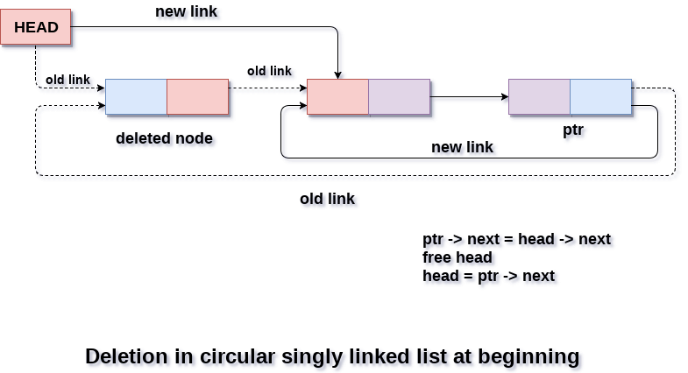

Slide 18
Algorithm
Step 1: IF HEAD = NULL
Write UNDERFLOW Go to Step 8 [END OF IF]
Step 2: SET PTR = HEAD
Step 3: Repeat Step 4 while PTR → NEXT != HEAD
Step 4: SET PTR = PTR → next
[END OF LOOP]
Step 5: SET PTR → NEXT = HEAD → NEXT
Step 6: FREE HEAD
Step 7: SET HEAD = PTR → NEXT
Step 8: EXIT

Slide 19
Deletion in Circular singly linked list at the end
There are three scenarios of deleting a node in circular singly linked list at the end.
Scenario 1 (the list is empty)
If the list is empty then the condition head == NULL will become true, in this case, we just need to print underflow on the screen and make exit.
if(head == NULL)
{
printf("\nUNDERFLOW");
return;
}
Scenario 2(the list contains single element)
If the list contains single node then, the condition head → next == head will become true. In this case, we need to delete the entire list and make the head pointer free. This will be done by using the following statements.
if(head->next == head)
{
head = NULL;
free(head);
}

Slide 20
Scenario 3(the list contains more than one element)
If the list contains more than one element, then in order to delete the last element, we need to reach the last node. We also need to keep track of the second last node of the list. For this purpose, the two pointers ptr and preptr are defined. The following sequence of code is used for this purpose.
ptr = head;
while(ptr ->next != head)
{
preptr=ptr;
ptr = ptr->next;
}
now, we need to make just one more pointer adjustment. We need to make the next pointer of preptr point to the next of ptr (i.e. head) and then make pointer ptr free.
preptr->next = ptr -> next;
free(ptr);

Slide 21
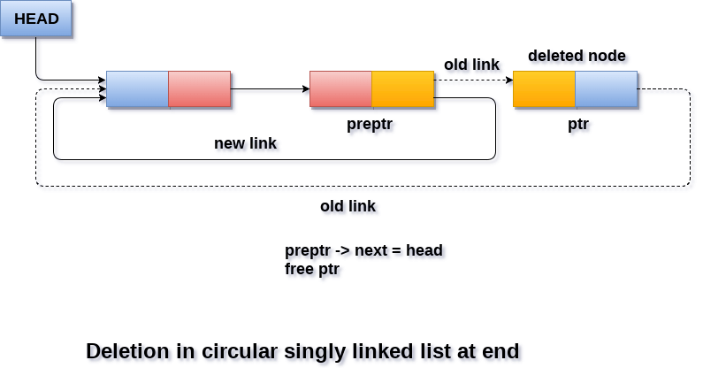

Slide 22
Algorithm
Step 1: IF HEAD = NULL
Write UNDERFLOW Go to Step 8 [END OF IF]
Step 2: SET PTR = HEAD
Step 3: Repeat Steps 4 and 5 while PTR -> NEXT != HEAD
Step 4: SET PREPTR = PTR
Step 5: SET PTR = PTR -> NEXT
[END OF LOOP]
Step 6: SET PREPTR -> NEXT = HEAD
Step 7: FREE PTR
Step 8: EXIT

